Slide 1
JJAB Inc.
A very professional presentation

Slide 2
INTRO:
Introducing… JJAB Inc. !!
  Jackie: The donut giver
  Jake: The “Brains” of the trading world
  Alex: The “Motivator”
  Bowling, Lauren: The extremely professional one who yells at people when they don’t take notes, make bad trades, or don’t do their work
We are an okay stock team to work with
We represent the most beautiful, amazing, intelligent, and inspirational client ever…. The one, the only…
  JILL CAMPBELL
We made some money, we lost some money, but at the end of the day we had fun!

Slide 3
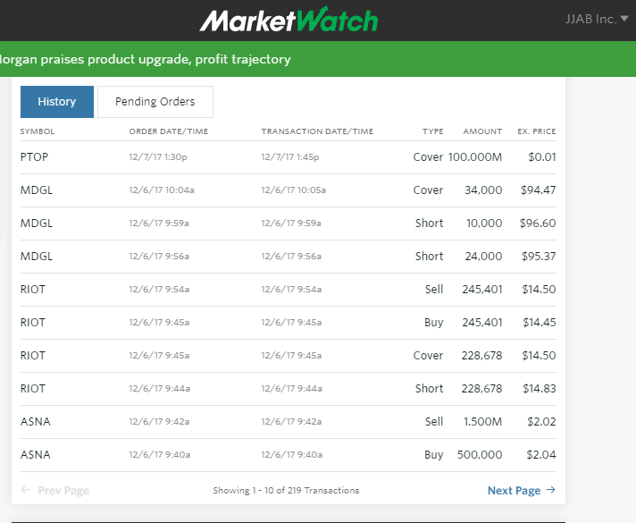
TRADING: OVERVIEW

Slide 4
TRADING: EXAPLES

Slide 5
TRADING: OUTCOMES

Slide 6
NEW STRATEGY:

Slide 7
NEW STRATEGY:

Slide 8
NEW STRATEGY:
Risks:

Slide 9
COLLABORATION

Slide 10
CLIENT: CHALENGES

Slide 11
CLIENT: SUCCESSES

Slide 12
CONCLUSION

